Slide 1
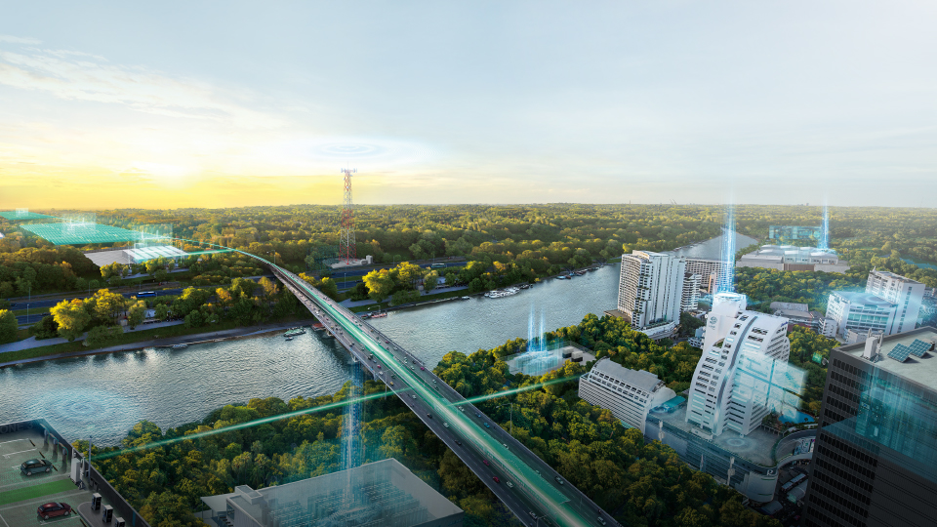
TE-Basic C# Programming

Slide 2
Course Outline
Introduction of C#
IDE
Data Type
Condition and Loop
OOP Programming
Windows Form app
Others
FAQ

Slide 3
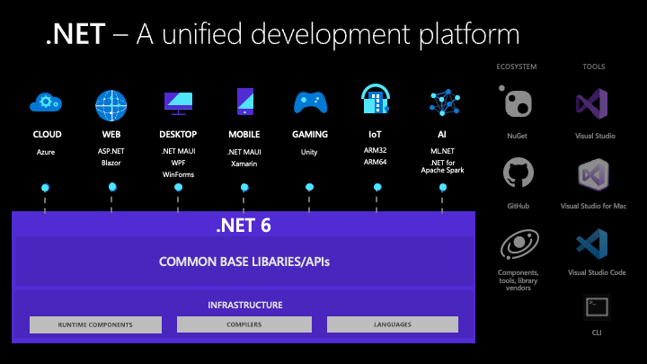
Introduction of C#
C# (pronounced "See Sharp") is a modern, object-oriented, and type-safe programming language. C# has its roots in the C family of languages and will be immediately familiar to C, C++, Java, and JavaScript programmers.
C# is a programming language, .NET is a blanket term that tends to cover both the .NET Framework (an application framework library) and the Common Language Runtime which is the runtime in which .NET assemblies are run.
You can create .NET apps for many operating systems, including:
Windows
macOS
Linux
Android
iOS

Slide 4
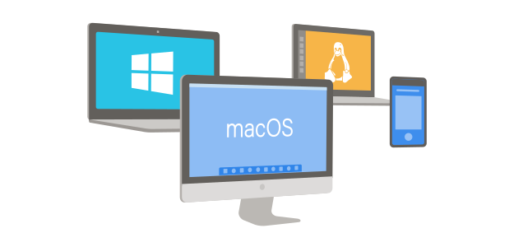

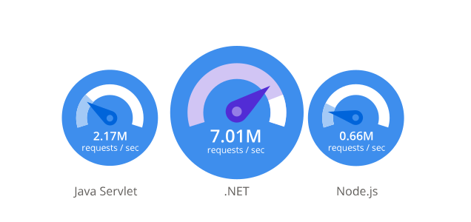

Why Choose .NET?
Productive
.NET helps you develop high quality applications faster. Modern language constructs like generics, Language Integrated Query (LINQ), and asynchronous programming make developers productive.
Any app, any platform
Open source
With .NET you can target any application type running on any platform. Developers can reuse skills and code across all of them in a familiar environment. That means developers can build apps faster, with less cost.
The .NET Foundation is an independent non-profit supporting the innovative, commercially friendly, open source .NET ecosystem. .NET has over 100,000 contributions from developers from over 3,700 companies outside of Microsoft.
Performance where it matters
Large ecosystem
With over 5,000,000 .NET developers worldwide, you can leverage the large ecosystem by incorporating libraries from the NuGet package manager and the Visual Studio Marketplace. Find answers to technical challenges from the community, our MVPs, and our large support organization.
Performance compare

Slide 5
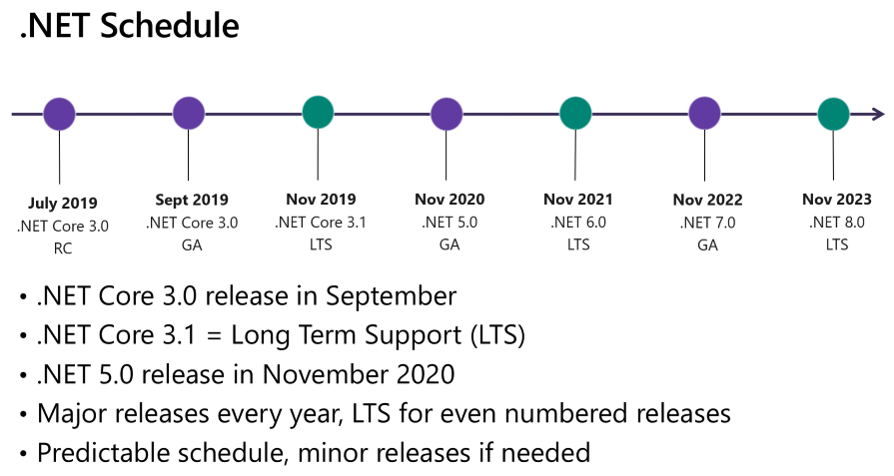
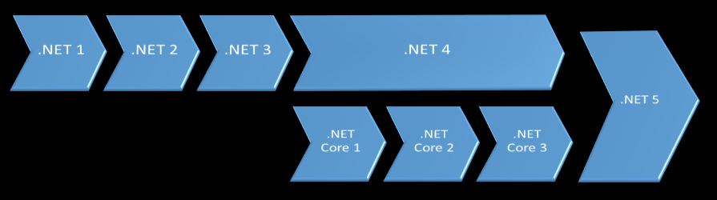
Dotnet History

Slide 6
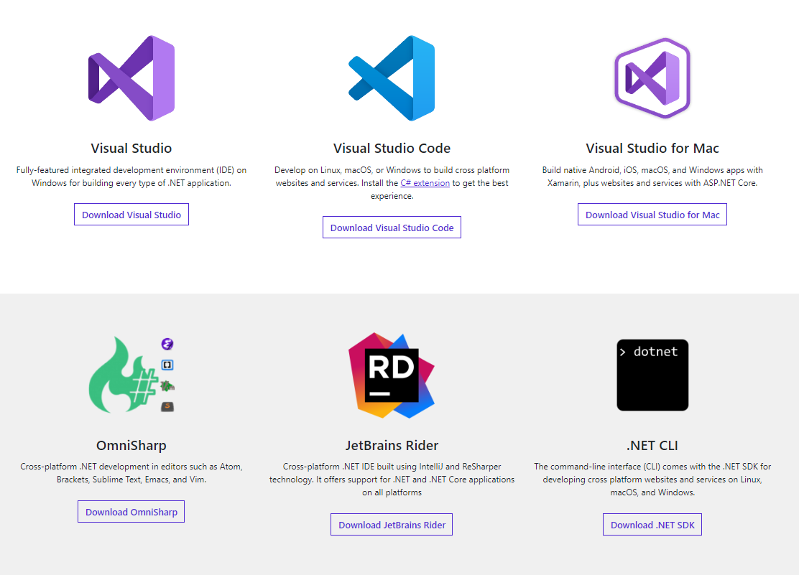
.NET Tools & Editors
https://visualstudio.microsoft.com/downloads/

Slide 7
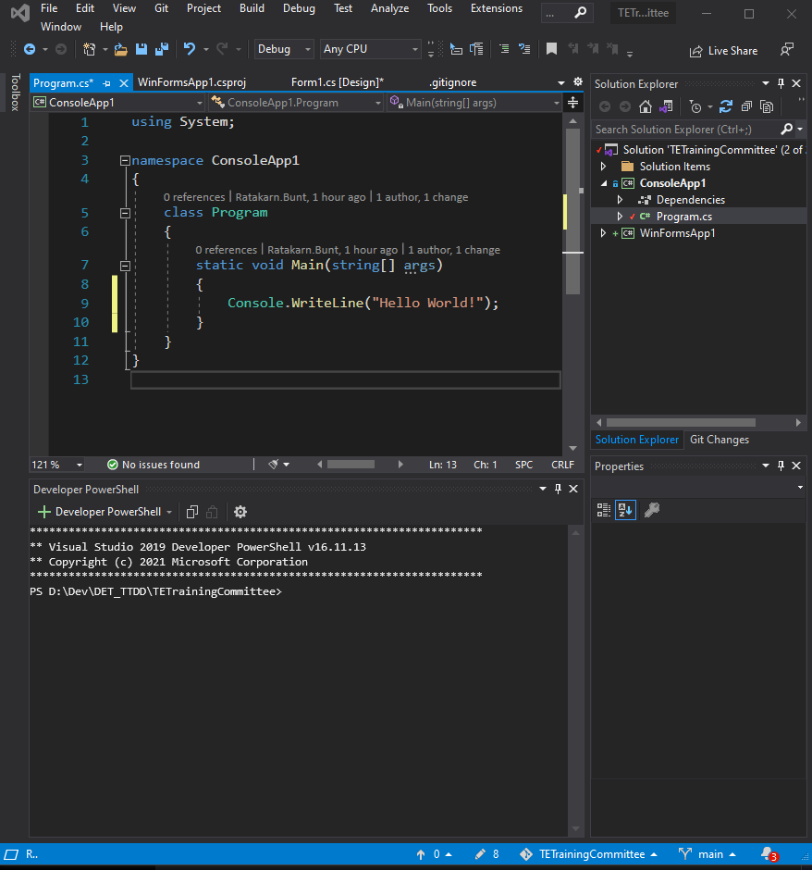
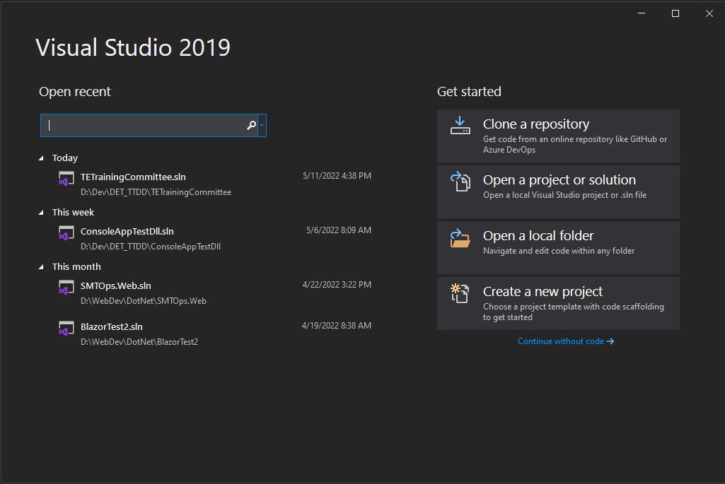
Visual Studio 2019

Slide 8
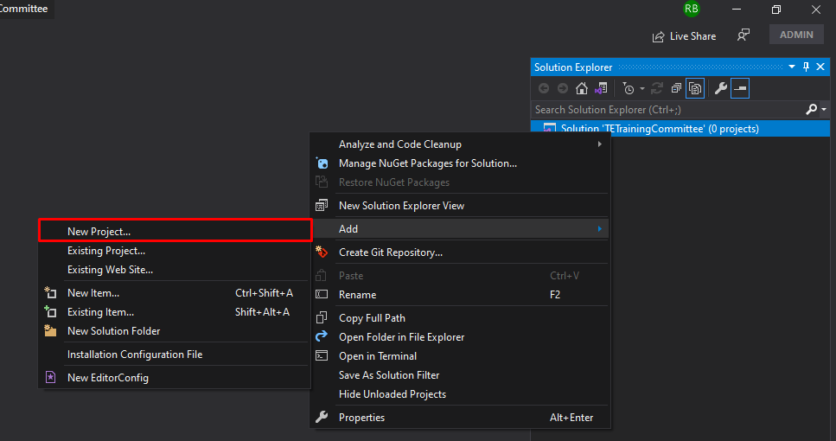
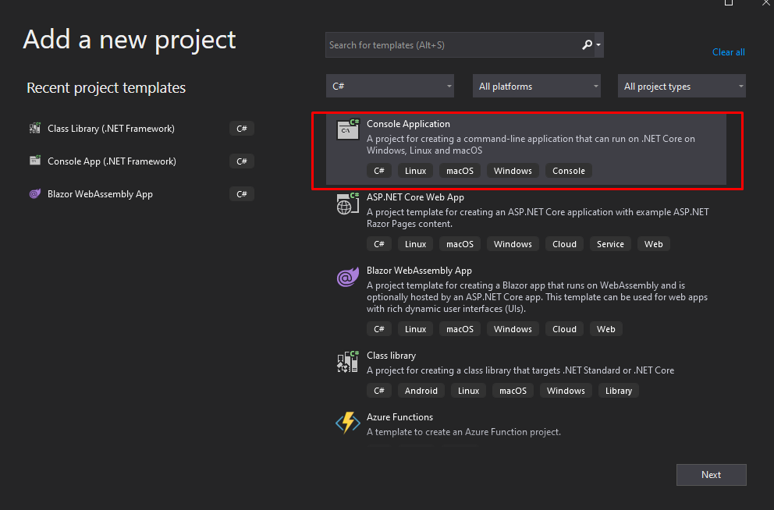
Console App
1
2

Slide 9
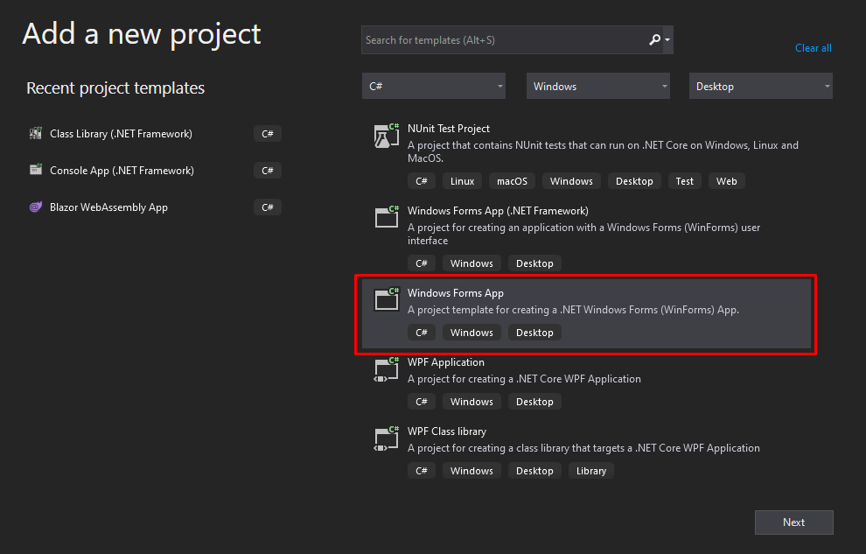
Window Form App
1
2

Slide 10
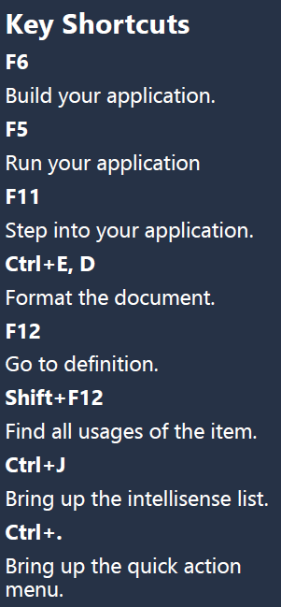
Keys to C#
1. Most lines end with a semi-colon. Typically, the exception to this is a line that is followed by an opening curly brace.
2. C# is case sensitive.
3. Every opening curly brace, parenthesis or bracket needs a closing one.
Application Types
Desktop Applications
These are applications that create executable (exe) files. This type includes Console Applications, Windows Forms Applications, and WPF Applications.
Web Applications
Web applications are run from a web server. Typically this is Internet Information Server (IIS). Examples of this type includes ASP.NET applications, ASP.NET MVC applications and Web API applications.
Library Applications
Library applications are not designed to be used by themselves. Instead, they support other application types. An example of this type is the Class Library Application. It allows you to create code that can be used in multiple applications by referencing the dll file that the library creates.

Slide 11
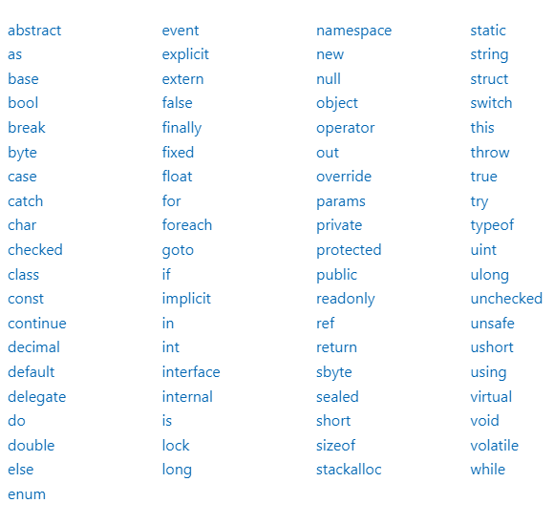
Keywords
Keywords are predefined, reserved identifiers that have special meanings to the compiler. They cannot be used as identifiers in your program unless they include @ as a prefix. For example, @if is a valid identifier, but if is not because if is a keyword.

Slide 12
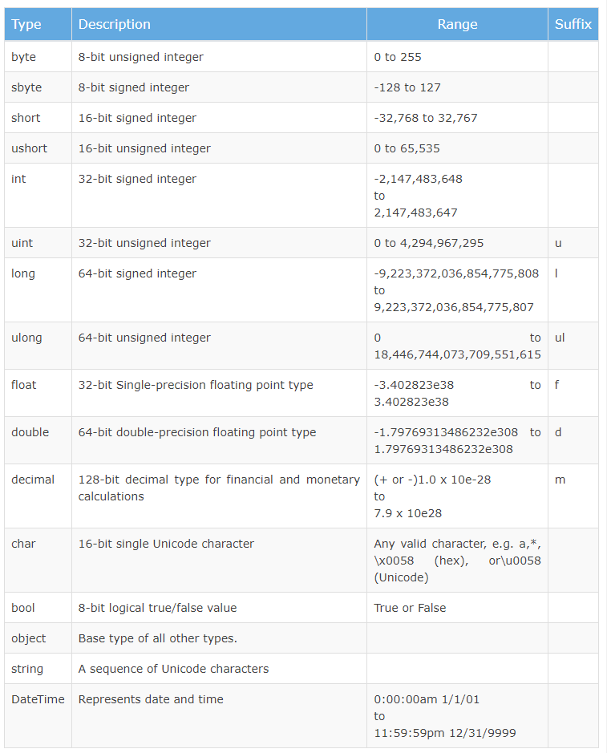
Predefined Data Types in C#

Slide 13
Basic Variables
Common Types
These are the variable types that you will be using most often when you are creating applications.
string
Explanation: Holds up to two billion Unicode characters. Basically, any character(s) you want in between double quotes.
Example Values: “Hello World”, “1”, “Anything I ^#@&* want!”, “”
bool
Explanation: Holds either true or false.
Example Values: true, false

Slide 14
Basic Variables
int
Explanation: Holds a signed whole number that goes from roughly negative two billion to positive two billion. The number cannot have a decimal in it (thus, whole number). This is equivalent to Int32 and is 32-bit in size.
Example Values: 586, -12, 0, 941
double
Explanation: Holds a signed, possibly non-whole number that is 64-bit in size. A double is used for most non-whole number operations. The exception is for operations where extreme precision are needed such as financial transactions. The double type only holds significant digits to the 16th place after the decimal point – fine for practically anything except money and astrophysics. Basically, use double for any number that might have a decimal point in it unless that value represents money, in which case you should store that value in a decimal type.
Example Values: 18.2514874, 21, -4.12

Slide 15
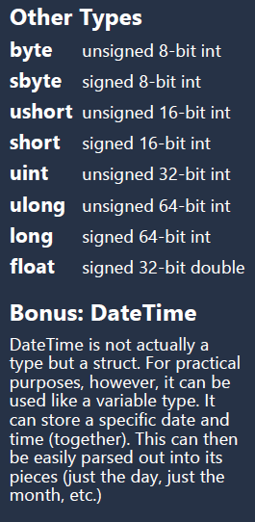
Basic Variables
decimal
Explanation: Holds a signed, possibly non-whole number that is 128-bit in size. A decimal is used for the most precise number operations. It holds significant digits to 28 places after the decimal point. In practical terms, use the decimal type for all variables that are storing money values, otherwise use double.
Example Values: 18.2514874, 21, -4.12
Definitions
signed
A number that can be positive or negative. Unsigned would be a number that is positive only.
bit
A unit of size. For instance, 16-bit is 65,535 (unsigned) where 17-bit would be double that in size.
object
A variable type that indicates that any type can be stored inside of it. Typically used for unknown types.

Slide 16
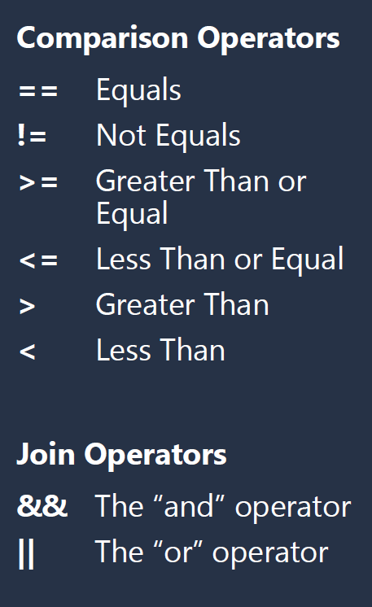
Conditionals
If Statement
Runs the code inside the curly braces in the event that the statement inside the parenthesis evaluates to true. Sometimes the if statement is paired with the else or if else statements.
Example
if (userAge == 15)
{
// The user's age is 15
}
Else Statement
Must be attached to an if statement (but not required for an If statement to ex-ist). The code inside the curly braces runs only if the statement inside the if statement’s parenthesis evaluates to false. Instead of a direct else, an else if may be used to operate another if statement instead. These can be chained togeth-er.
Example
if (userAge == 15)
{
// The user's age is 15
}
else if (userAge == 23)
{
// The user's age is 23
}
else
{
// The user's age is not 15 or 23
}

Slide 17
Conditionals
Switch Statement
Evaluates the value inside the parenthesis and compares that to the case values. If the values match, the code inside that case statement is executed (but no other code). A break statement must be included at the end of a case statement section. The default case code is executed in the event that no case matches.
Example
switch (userAge)
{
case 15:
// This user is 15
break;
case 23:
// This user is 23
break;
default:
// This user did not match any case statement
break;
}

Slide 18
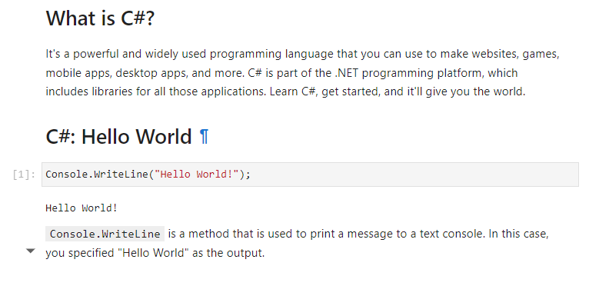
Hello World

Slide 19
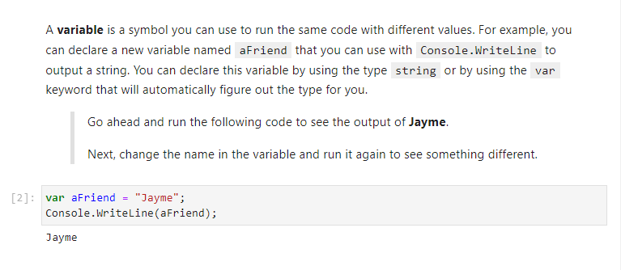
Declare and use variables

Slide 20
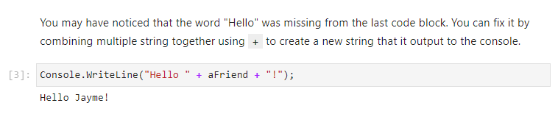
Combining Strings

Slide 21
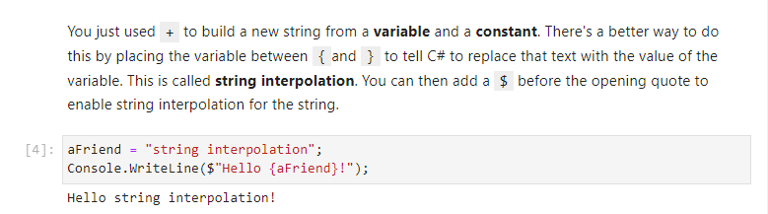
String Interpolation

Slide 22
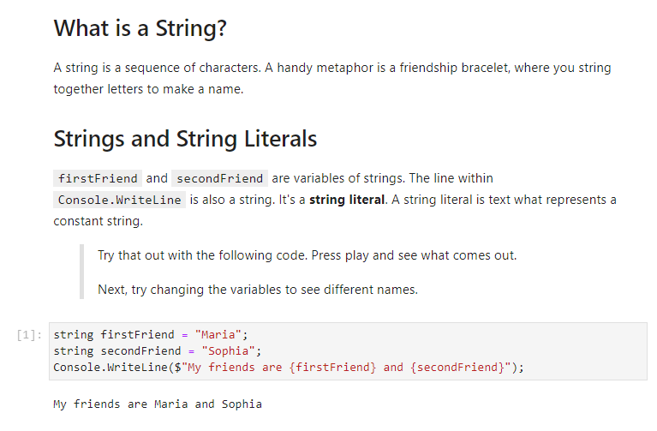
The Basics of Strings

Slide 23
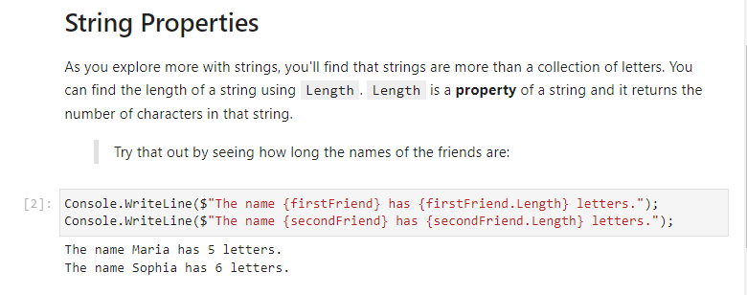
The Basics of Strings

Slide 24
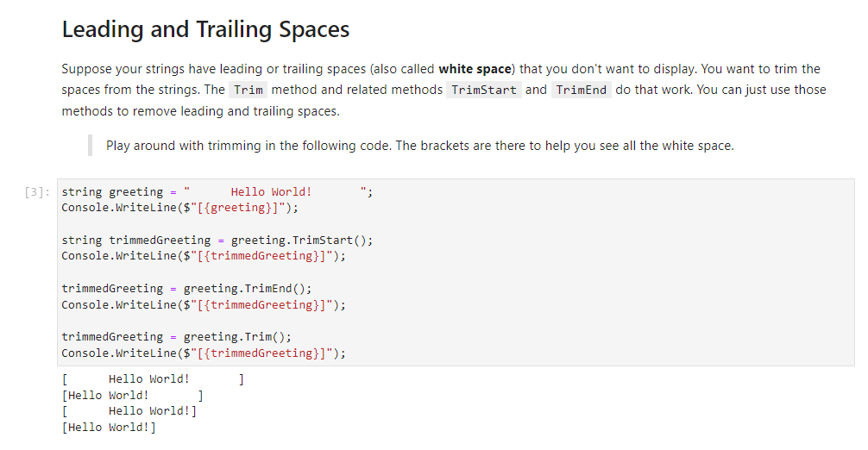
String Methods

Slide 25
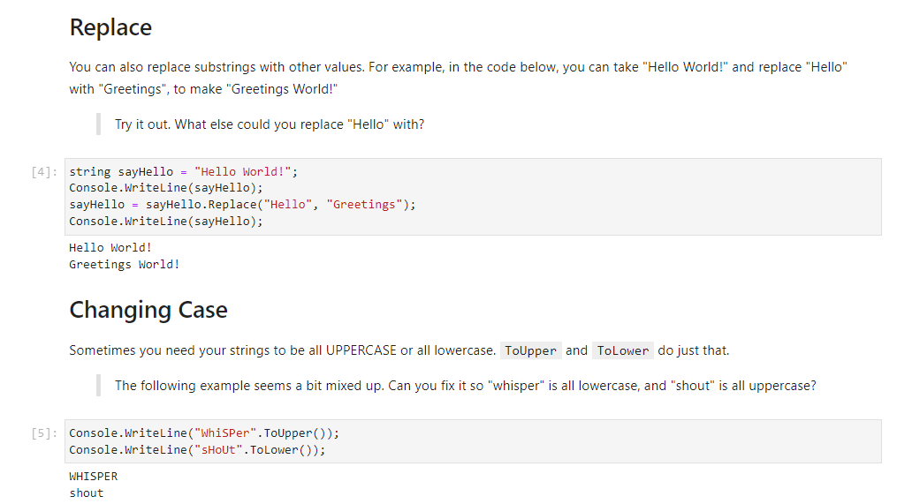
String Methods

Slide 26
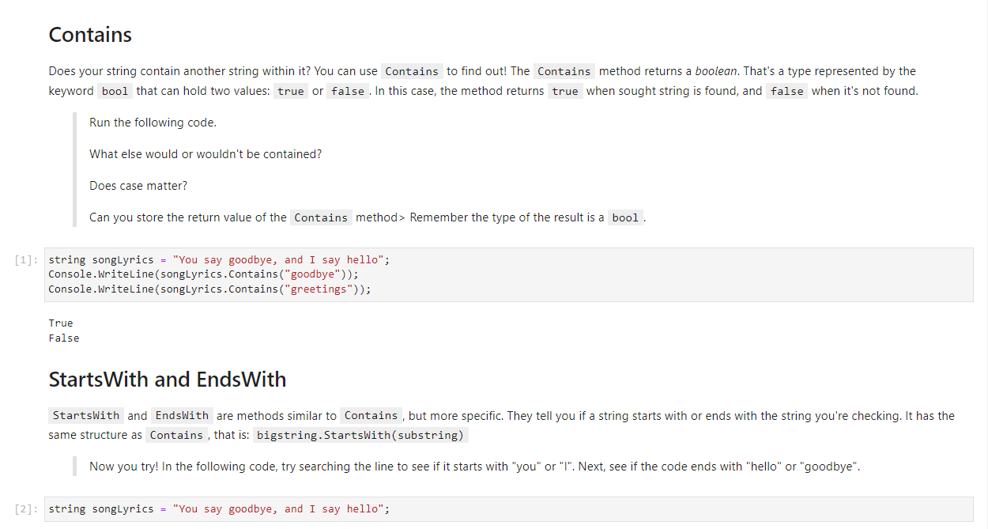
Searching Strings

Slide 27
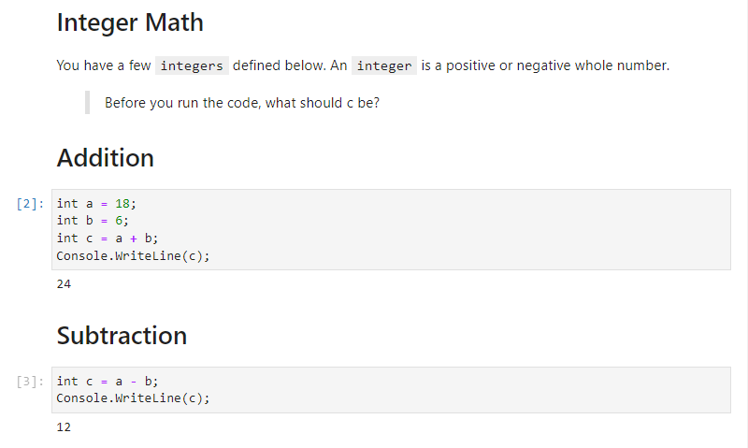
Numbers and Integer Math

Slide 28
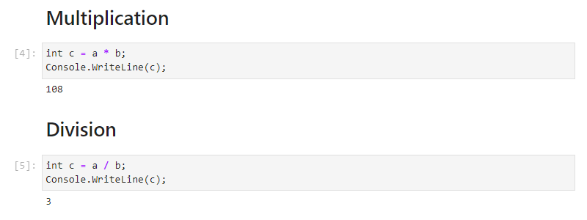
Numbers and Integer Math

Slide 29
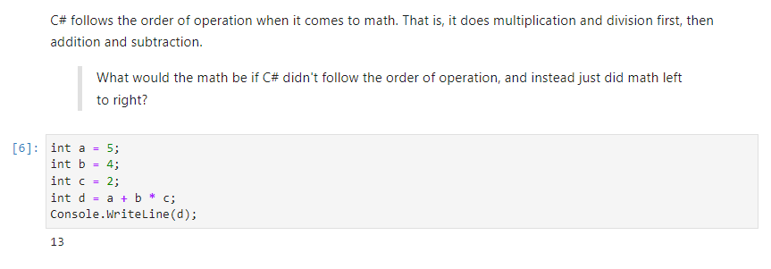
Order of operations

Slide 30
Order of operations

Slide 31
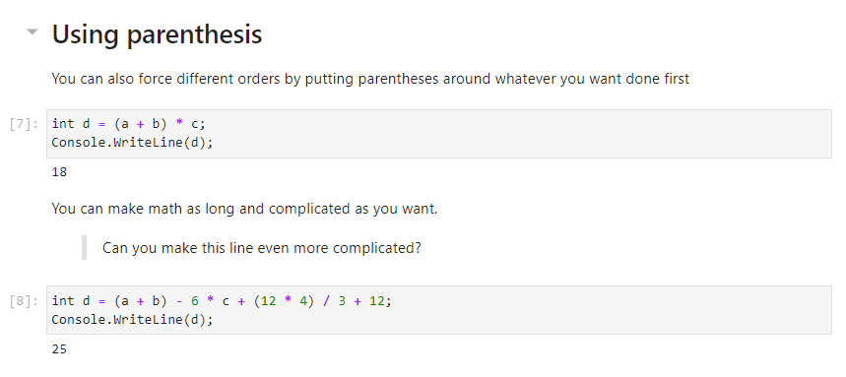
Order of operations

Slide 32
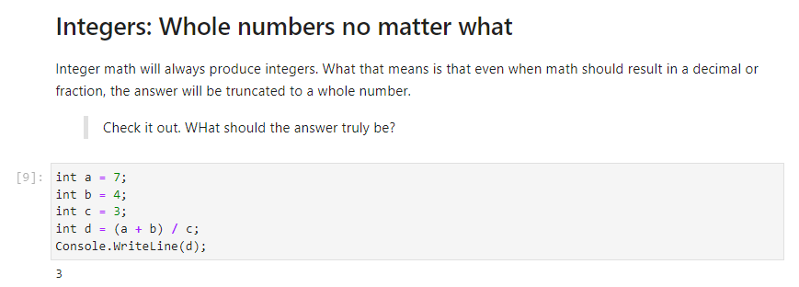
Order of operations

Slide 33
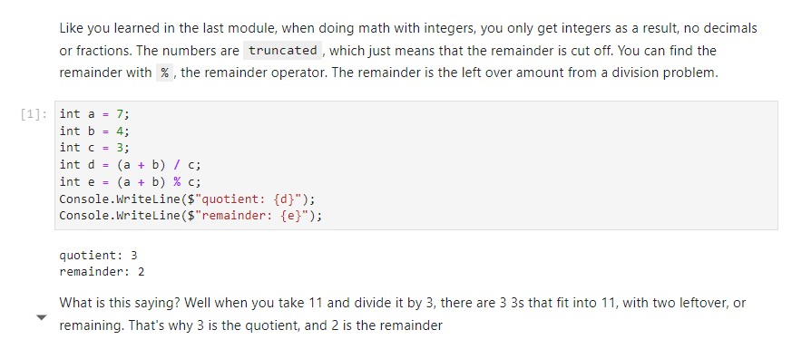
Numbers and Integer Precision

Slide 34
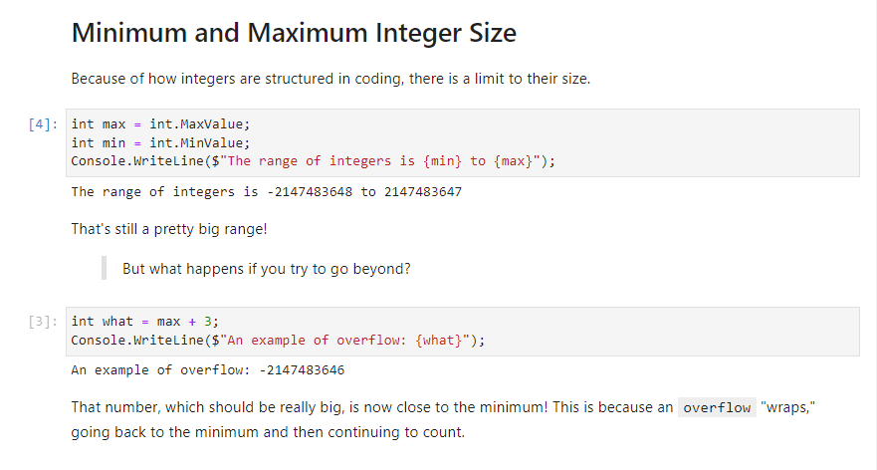
Numbers and Integer Precision

Slide 35
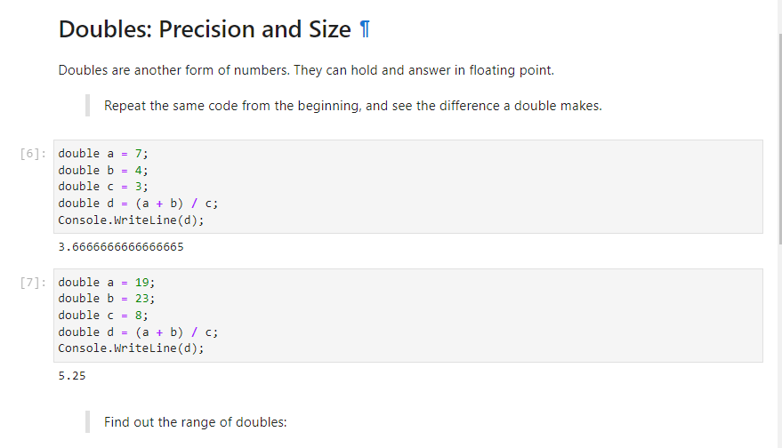
Numbers and Integer Precision

Slide 36
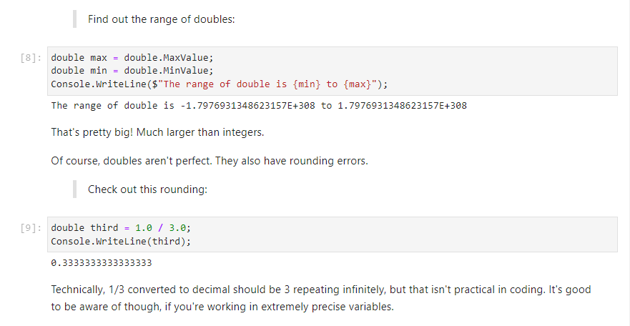
Numbers and Integer Precision

Slide 37
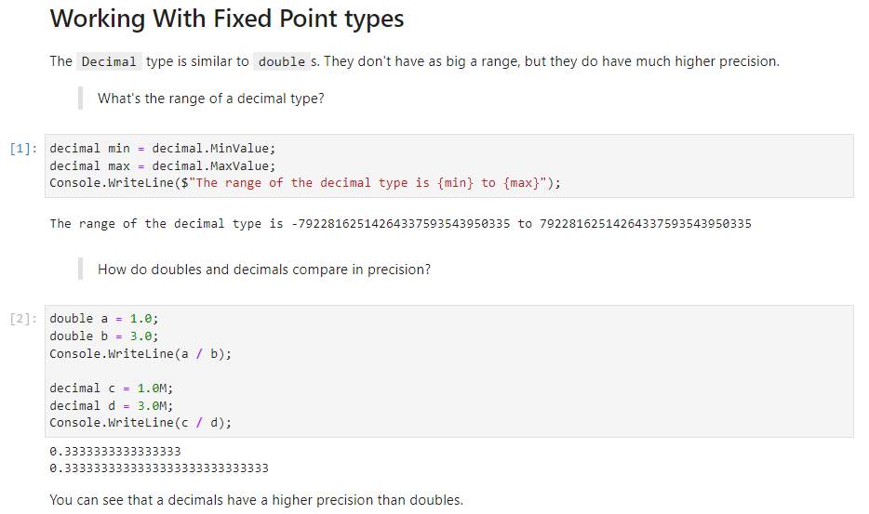
Numbers and Decimals

Slide 38
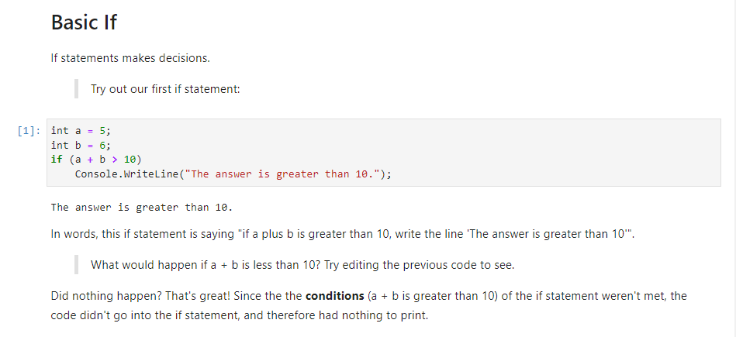
Branches (if)

Slide 39
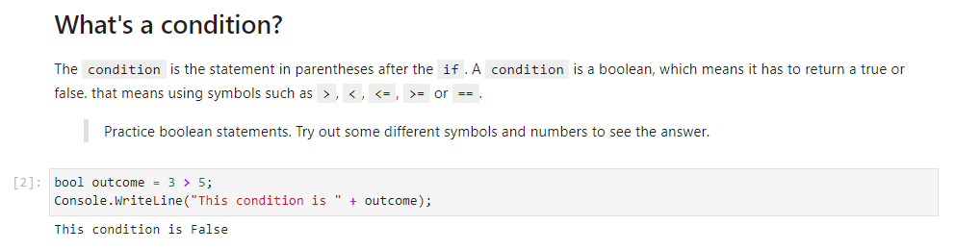
Branches (if)

Slide 40
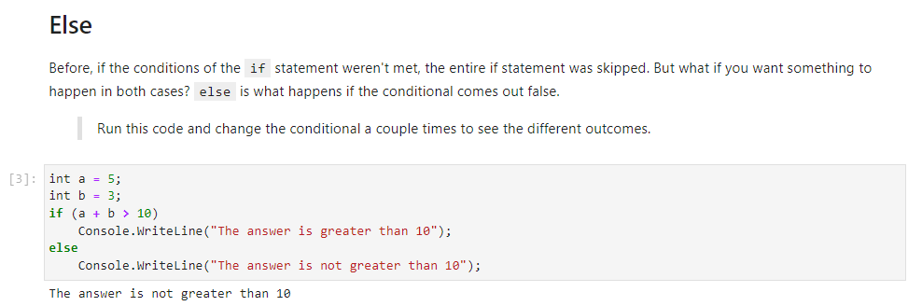
Branches (if)

Slide 41
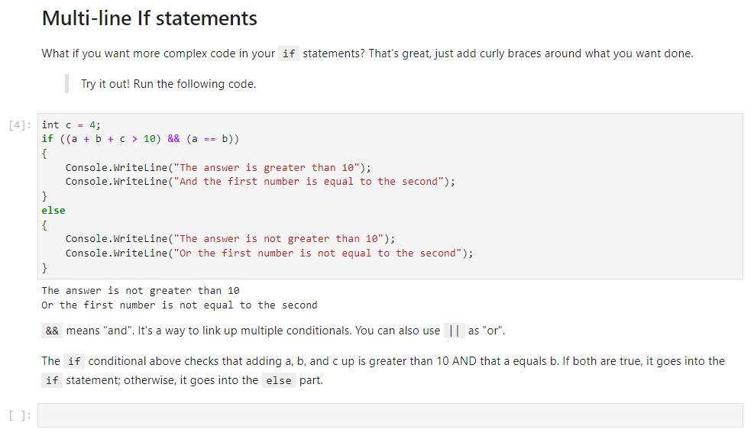
Branches (if)

Slide 42
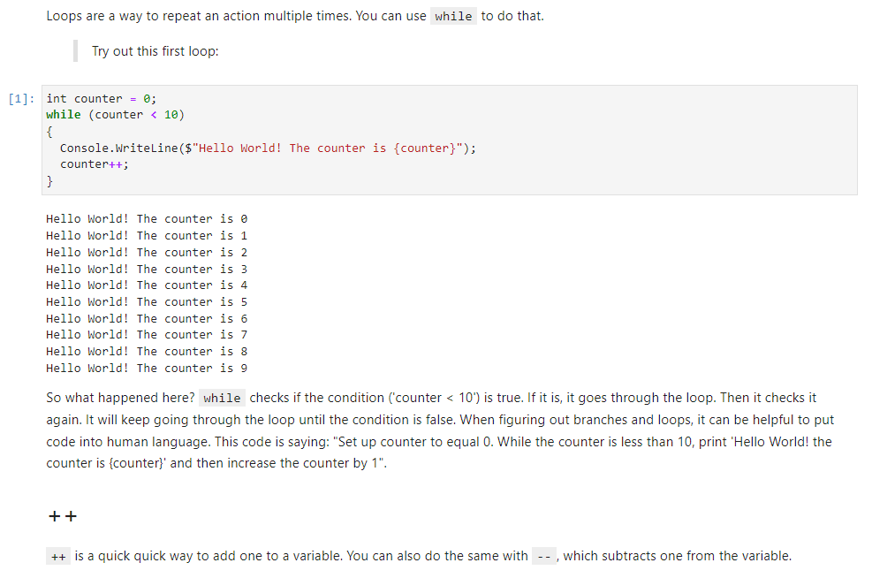
What Are Loops?

Slide 43
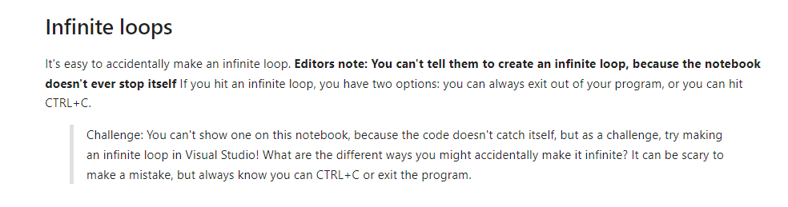
What Are Loops?

Slide 44
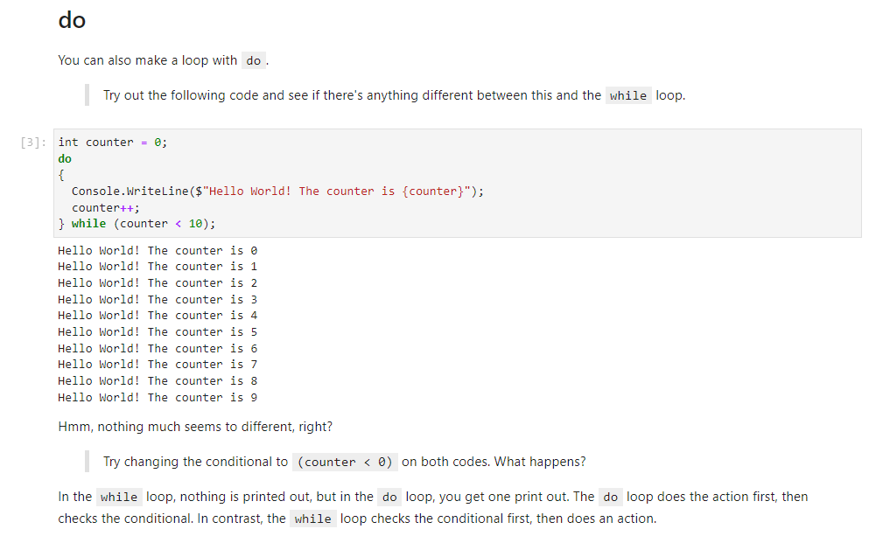
What Are Loops?

Slide 45
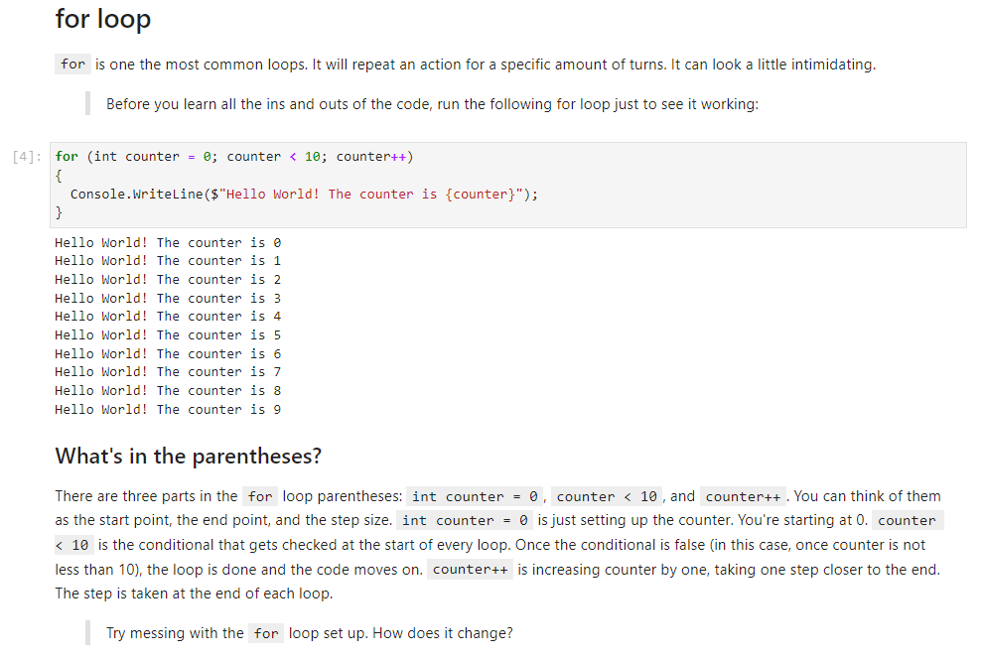
What Are Loops?

Slide 46
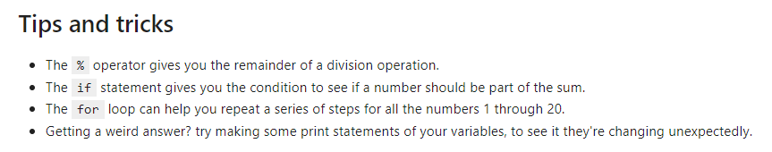
Combining Branches and Loops

Slide 47
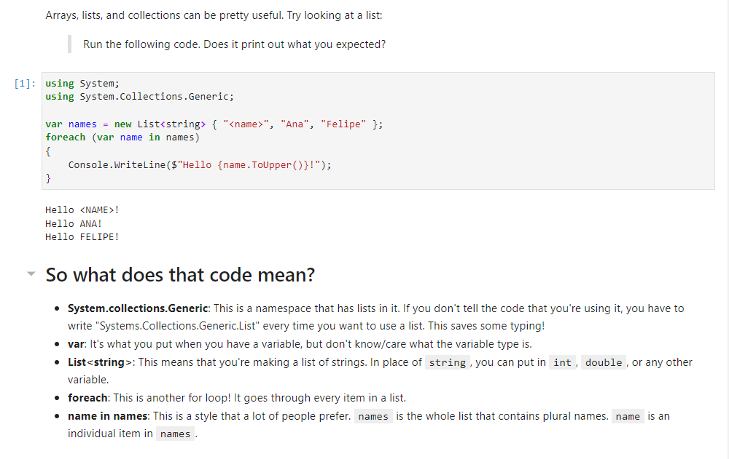
Arrays, Lists, and Collections

Slide 48
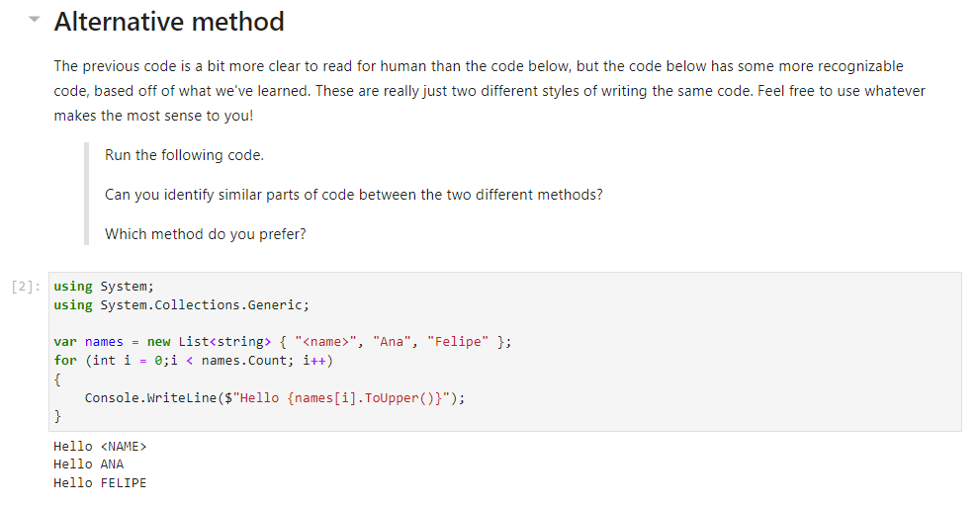
Arrays, Lists, and Collections

Slide 49
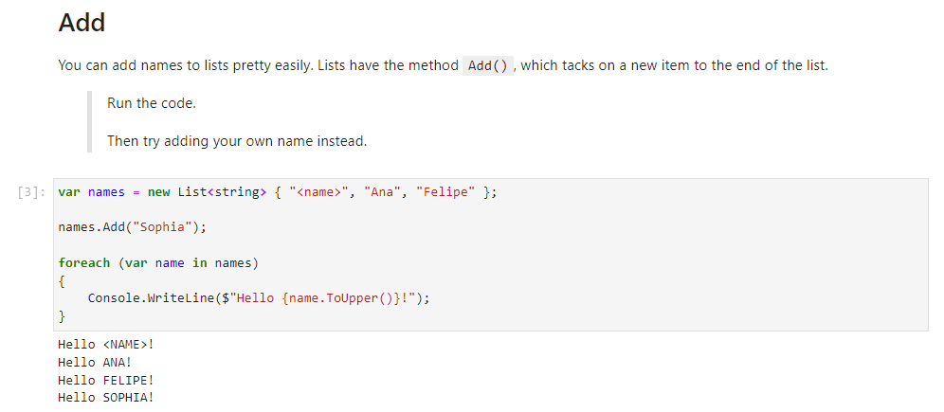
Arrays, Lists, and Collections

Slide 50
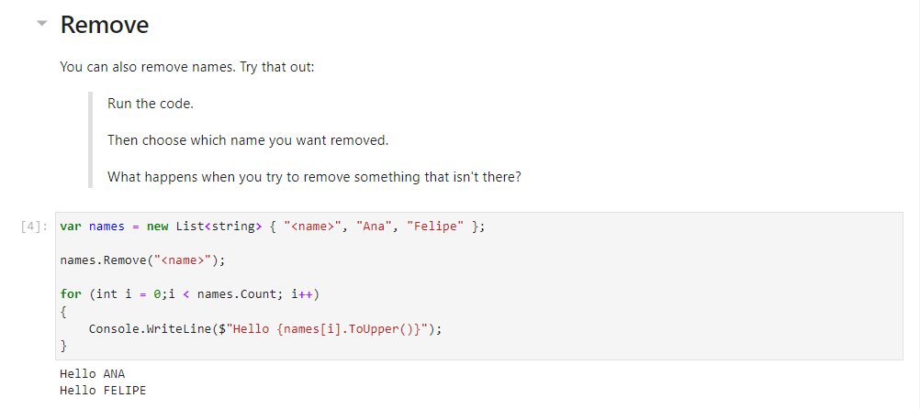
Arrays, Lists, and Collections

Slide 51
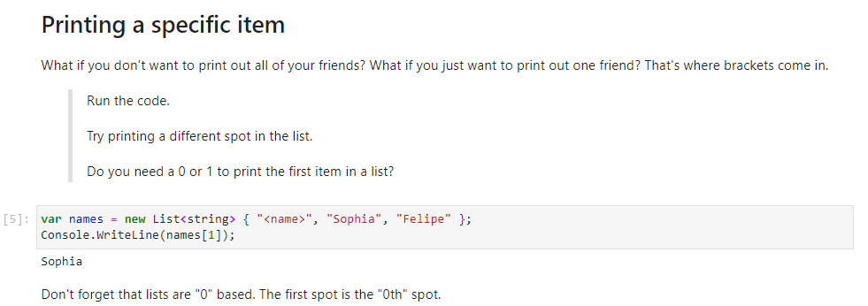
Arrays, Lists, and Collections

Slide 52

Search, Sort, and Index Lists

Slide 53

Search, Sort, and Index Lists

Slide 54


Search, Sort, and Index Lists

Slide 55

Lists of Other Types

Slide 56

Lists of Other Types

Slide 57

Lists of Other Types

Slide 58

Objects and Classes

Slide 59

Objects and Classes

Slide 60

Objects and Classes

Slide 61

Objects and Classes

Slide 62

Objects and Classes

Slide 63



Objects and Classes

Slide 64

Methods and Members

Slide 65

Methods and Members

Slide 66

Methods and Members

Slide 67

Methods and Members

Slide 68

Methods and Members

Slide 69


Methods and Members

Slide 70

Methods and Members

Slide 71

Methods and Members

Slide 72


Methods and Members

Slide 73


Methods and Members

Slide 74

Methods and Members

Slide 75

Methods and Exceptions

Slide 76

Methods and Exceptions

Slide 77

Methods and Exceptions

Slide 78

Methods and Exceptions

Slide 79

Methods and Exceptions

Slide 80

Methods and Exceptions

Slide 81

Methods and Exceptions

Slide 82

Methods and Exceptions

Slide 83

Methods and Exceptions

Slide 84

Methods and Exceptions

Slide 85

Methods and Exceptions

Slide 86

Methods and Exceptions

Slide 87

Methods and Exceptions

Slide 88

Methods and Exceptions

Slide 89

Methods and Exceptions

Slide 90
Text

Slide 91

Corporate Mission
To provide innovative, clean and energy-efficient solutions for a better tomorrow.

Slide 92
Corporate Mission
To provide innovative, clean and energy-efficient solutions for a better tomorrow.

Slide 93
Corporate Mission
To provide innovative, clean and energy-efficient solutions for a better tomorrow.

Slide 94
Brand Promise Smarter. Greener. Together.
“Smarter" is our continuous innovation in power electronics technology.
“Greener" represents Delta's mission since our founding.
“Together“ is our business philosophy in building long-term partnership with our stakeholders.

Slide 95

Delta Group Overview
Founded in 1971
World’s Leader in Switching Power Supplies and DC Brushless Fans
Dedicated to providing:
Telecom Power Systems
Industrial Automation
Passive and Magnetic Components
Networking Products
Visual Displays
Data Center Infrastructure
Renewable Energy and Energy Storage
EV Charging Infrastructure

Slide 96


Delta Thailand Overview
Founded in 1988
Thailand’s largest listed electronics manufacturer on the Stock Exchange of Thailand (SET)
Business management center for Southeast Asia, India and Australia/ New Zealand markets
Product development management center with R&D centers in Bangkok (Thailand), Soest/ Teningen (Germany),UK, USA, India and Bucharest (Romania).
Manufacturing management center to synergize advanced technologies and highly efficient production across manufacturing plants in Thailand, India, Slovakia and Myanmar.

Slide 97



Delta Thailand Global Presence
Thailand
India
Europe
Source: Timeout
Source: Britannica
Source: Master Portal
Bangpoo Plant – Plant 1
Gurgaon Plant (HQ)
Slovakia- Dubnica Plant
Bangpoo Plant – Plant 3
Rudrapur Plant
Germany- Soest R&D
Bangpoo Plant 5 (HQ)
Hosur Plant
Germany- Teningen R&D
Wellgrow Plant 6
Wellgrow Plant 7

Slide 98
Business Categories
We are dedicated to creating a cleaner and more energy-efficient tomorrow

Slide 99








Business Categories
Power
Electronics
Components
Power & System
Automotive Electronics
Fans & Thermal Management
Innergie
Automation
Industrial Automation
Building Automation
Infrastructure
ICT Infrastructure
Energy Infrastructure and Industrial Solutions
Visual Display- Vivitek

Slide 100







Delta Green Solutions
Industrial Automation
Datacenter
Telecom Energy
EV Charging
Display and Monitoring
Building Automation
Smart Energy

Slide 101

Energy Savings for Customers
From 2010 to 2020,
Delta’s high efficiency products and solutions helped customers
Electricity Consumption
Savings of
33.5 B kWh
Carbon Emissions
Reduction
17.8 M Tons

Slide 102















Success Stories
 | Articulated robots applied for function testing of SCARA robots to shorten testing time. High-power UPS solutions for Alibaba
 | EV charging solutions in Northern and Western Europe.
 | InfraSuite datacenter solution for a web-hosting company in Berlin that serves a large Germany shopping website.
PV inverters for 75.4 MW solar energy project in Denmark.
Ultron and Modulon series UPS 100-160 kVA safeguard operations of MRI and CT Scan equipment in the Philippines.
 | Rooftop Solar System with 27 30 kW RPI M30A saves 1,226 MWh/Year for farm in Queensland, Australia. Active Power Filters (APF) for power management of electrical equipment in a landmark tower in Melbourne, Australia.
 | LED-based DLP Video walls for the first traffic management center in Bangalore, India. Solar farm with 20 Delta C500 inverters generates an up to 1,200 MWh/Month in Kadappa, India. Smart monitoring and power management solution for a countrywide ATM network in India.
 | PV inverters for rooftop solar solution that generates an average of 165 MWh/Month in Kolar, India.
 | Modulon DPH 200 kVA for the datacenter of one of The top telecom companies in Thailand.
 | Ultron and Amplon series UPS 20-260 kVA protect power for operations at a top global thin film transistor LCD panel manufacturer in Singapore.

Slide 103








Delta Solutions Address Global Megatrends
Rapid Urbanization
(City Infra and Smart Application)
Sustainable City and Building
Connectivity and e-Commerce
Technology Adoption
(Connected and Smart Manufacturing)
Climate Change
(Renewables and Energy Application)
Energy Infrastructure
Manufacturing Expansion
Demographic Shift
(Population Bonus and Middle Class)

Slide 104
Award & Recognition

Slide 105








ESG Award & Recognition
Dow Jones Sustainability World Index 2021
By S&P Global
ASEAN Energy Awards 2020
Large Industry- Energy Management
By ASEAN Centre for Energy
2020 & 2021
Thailand Energy Awards
By The Ministry of Energy
2019
SET Best Sustainability Excellence Award
By Stock Exchange of Thailand
2017 - 2021
Listed in the FTSE4Good Emerging Index, part of London Stock Exchange Group
2019 Thailand’s Top
Corporate Brand Hall of Fame
By Chulalongkorn University
2018 Prime Minister’s Industry Award: CSR Category
By Ministry of Commerce
2016 - 2021
Excellence in CG Score
By IOD for CG Report

Slide 106


Where You Can Find Us
www.deltathailand.com

Slide 107
Smarter. Greener. Together.

